Slide 1
Principles of Class Design

Slide 2
Objectives
To introduce and understand some principles of class design
  The Open Closed Principle
  The Liskov Substitution Principle
  The Dependency Inversion Principle
  The Interface Segregation Principle

Slide 3
The Open Closed Principle
A module should be open for extension but closed for modification.
In other words, we want to be able to change what the modules do, without changing the source code of the modules.
Abstraction is the key to this principle

Slide 4
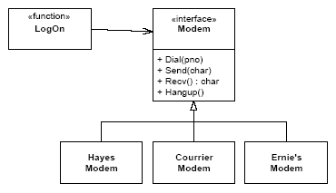
Example
Here the LogOn function depends only upon the Modem interface.
  Additional modems will not cause the LogOn function to change.
Thus, we have created a module that can be extended, with new modems, without requiring modification.

Slide 5
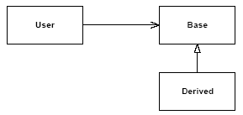
The Liskov Substitution Principle
Subclasses should be substitutable for their base classes.
If some function User takes an argument of type Base, then it should be legal to pass in an instance of Derived to that function.

Slide 6
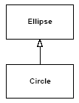
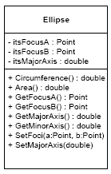

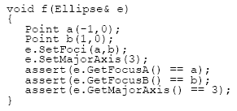
The Liskov Substitution Principle: The Circle/Ellipse Dilemma
A postcondition on the SetFoci of Ellipse guarantees that the input values got copied to the member variables, and that the major axis variable was left unchanged.
  Clearly Circle violates this guarantee because it ignores the second input variable of SetFoci. Therefore, Circle is not substitutable for Ellipse.

Slide 7
The Liskov Substitution
Principle (Cont’d)
Restating the Liskov Substitution Principle once again, a derived class is substitutable for its base class if:
  Its preconditions are no stronger than the base class method.
  Its postconditions are no weaker than the base class method.
In other words, derived methods should expect no more and provide no less.

Slide 8
The Dependency Inversion Principle
Depend upon abstractions. Do not depend upon concretions.
The reason is simple, concrete things change a lot, abstract things change much less frequently.

Slide 9
The Interface Segregation Principle
Many client specific interfaces are better than one general purpose interface.
If you have a class that has several clients, rather than loading the class with all the methods that the clients need, create specific interfaces for each client and multiply inherit them into the class.

Slide 10
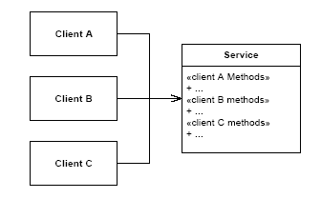
Fat Service with Integrated Interfaces
Whenever a change is made to one of the methods that ClientA calls, ClientB and ClientC may be affected. It may be necessary to recompile and redeploy them.

Slide 11
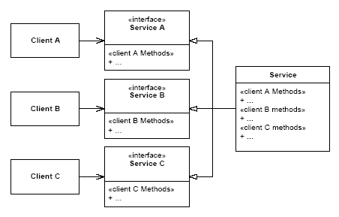
Segregated Interfaces
If the interface for ClientA needs to change, ClientB and ClientC will remain unaffected. They will not have to be recompiled or redeployed.

